Slide 1
Genetic Variants Conflict Prediction Using Machine Learning Algorithms
Author: Mawada Mohammed
University of Khartoum – Faculty of Medical Laboratory Science

Slide 2
Introduction
Genetic variants: Variations in DNA sequence that can influence individual traits and disease susceptibility.
Variant conflicts: Occurs when different laboratories or sources report conflicting interpretations of the pathogenicity or significance of a genetic variant
Challenges: Heterogeneity of Data Sources, Variability in Methodologies, Evolving Classification Criteria, and Limited Functional
Solution: Machine learning algorithms offer a powerful approach for predicting variant conflicts, providing valuable insights for personalized medicine and drug discovery.

Slide 3
Research Objectives
Develop machine learning models to accurately predict genetic variant conflicts.
Evaluate different algorithms and feature sets to optimize prediction performance.

Slide 4
Data and Methodology
1. Data Collection: The data was downloaded from Kaggle
2. Understanding the Data Structure: consider data types, and number of missing, duplicated and unique values.
3. Exploratory Data Analysis (EDA): gain a deeper understanding of the dataset.
4. Data Preprocessing: data cleaning, transformation, handling missing values, splitting the dataset, encoding categorical variables, and scaling.
5. Model Selection and Training: Identify suitable machine learning algorithms for conflicting genetics variants analysis.
6. Hyperparameter Tuning: grid search was used to optimize model hyperparameters.
7. Model Evaluation: accuracy, precision, recall, F1-score, and area under the ROC curve were used to assess model performance.

Slide 5
Results
Random Forest Classifier (RFC) was the most effective algorithm in predicting genetic variants conflicts with accuracy of 82.9, precision of 86.3, recall of 77.6, and f1-score of 81.7.

Slide 6
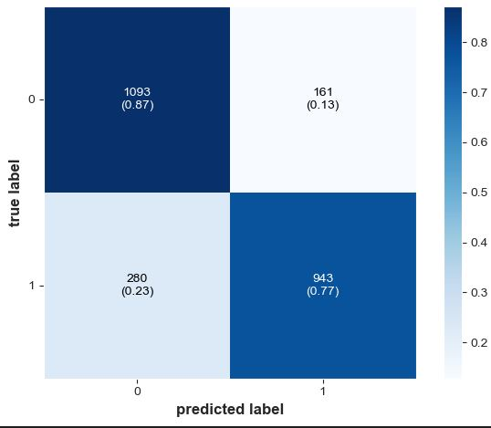
Confusion Metrix

Slide 7
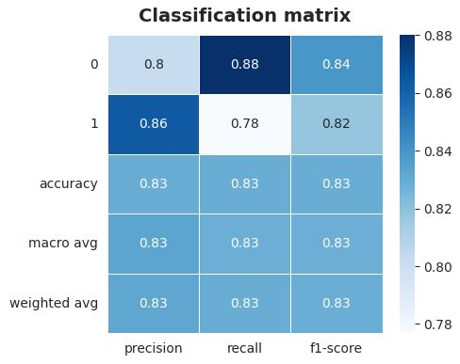
Classification Report

Slide 8
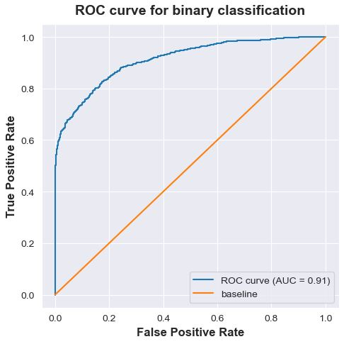
ROC Curve

